Slide 1

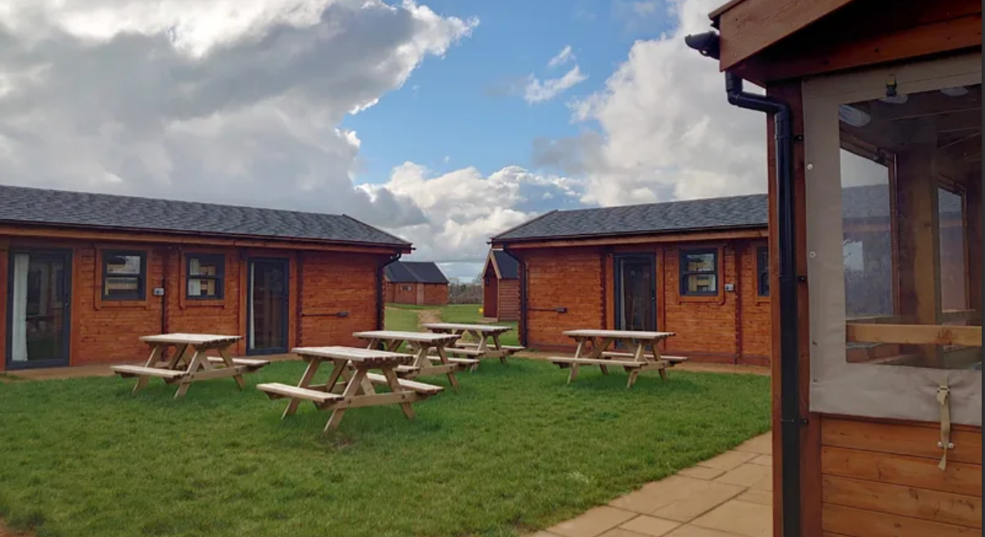
Year 5
Clanfield Residential
24th-26th June 2026

Slide 2
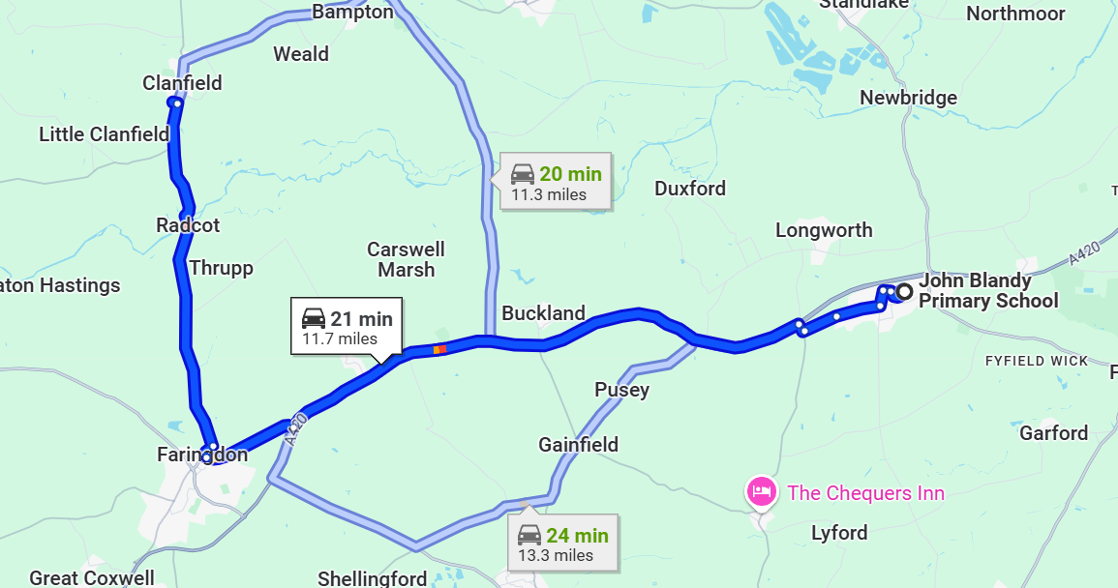
Where is Adventure Plus?

Slide 3
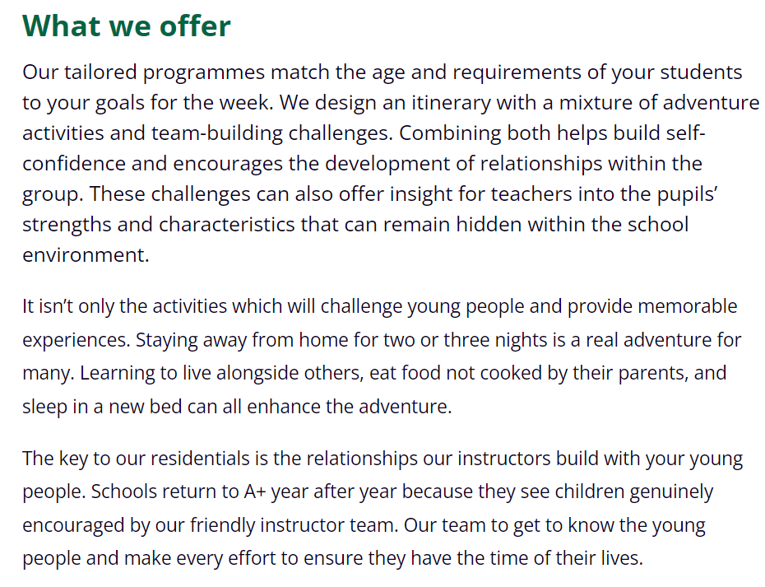

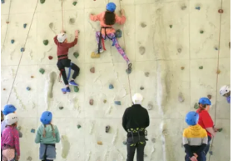
Adventure Plus Centre

Slide 4
Wednesday 24th – Friday 26th June 2026
Arrival and Collection
Parents will need to take to the site and from the site.
Please arrive at the site between 9:15-9:30am on the Wednesday.
Children will need to bring a snack and packed lunch for this day only.
Children will be collected from the site at approximately 2pm on Friday 26th June.
Please feel free to car share and just let adults know who is collecting the children on the Friday.

Slide 5
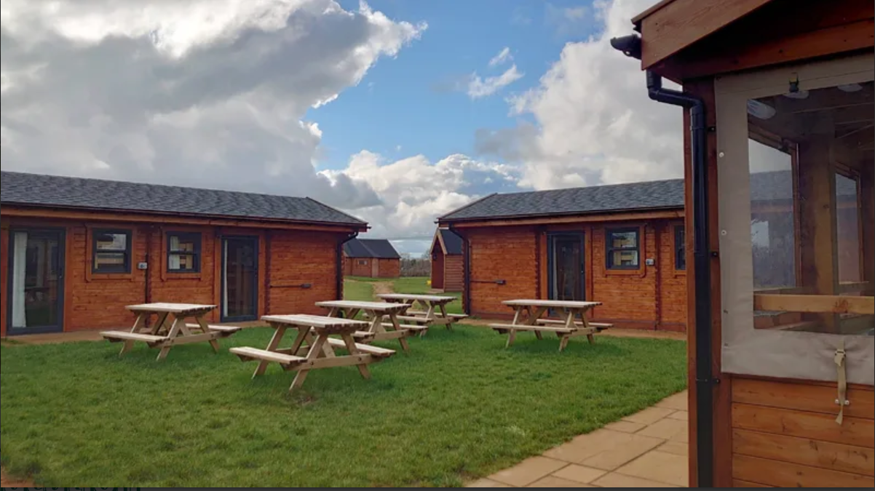
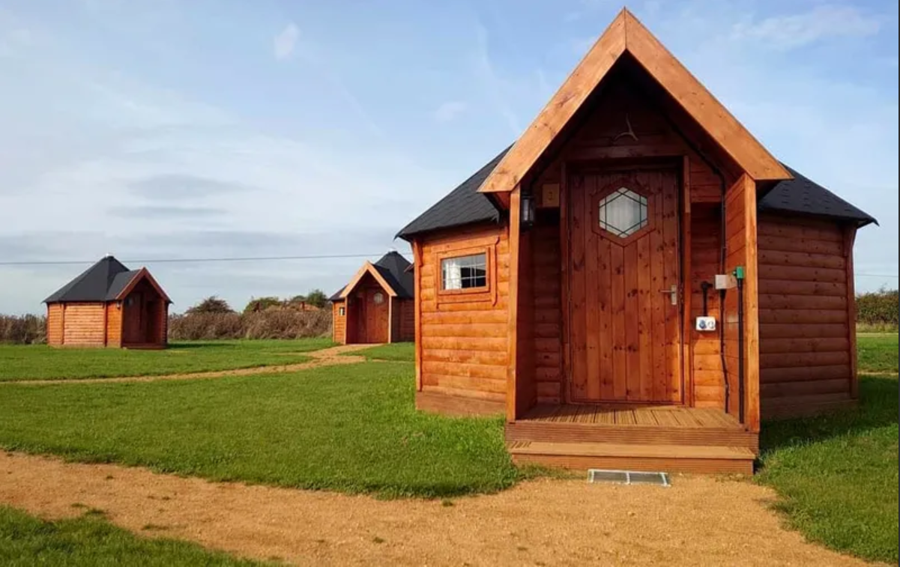
Accommodation- Timber Yurts

Slide 6
Timber Yurts
Each yurt sleeps up to 8 children.
Comfy bunk beds.
Boys and girls will be in separate yurts.
Shower and toilet block separate to yurts.
Yurts do not have heating- slippers/indoor shoes only inside.
Children to choose 1 or 2 people to share with and rooms will be organised accordingly.
Children will need to bring a single sheet, pillow, pillow cover, a sleeping bag and extra blanket.

Slide 7
Who will be going…
Some members of the Year 5/6 team and other John Blandy staff still to be confirmed.
Professional Outdoor Instructors run all the activities during the day and on the second night.
We will be the only school on site.

Slide 8
Food...
Children will need to bring a small snack and a drink for the first morning. They will also need to bring a packed lunch for the first day. After this, all food is provided.
Dietary requirements catered for- please see form and provide the information as soon as possible.

Slide 9
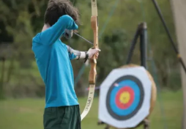
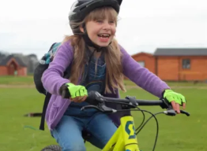
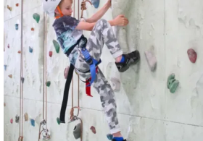
What activities will the children be doing during the day?
Archery
Climbing
Biking
Circus Skills
Fencing
Bushcraft
Team Games
Slacklining

Slide 10
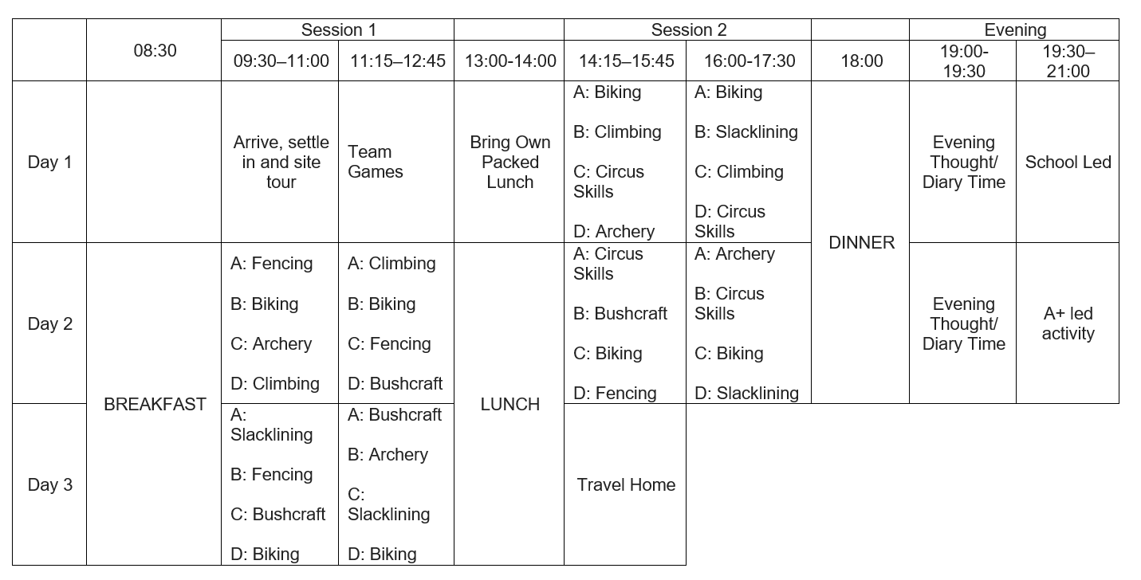
Sample timetable

Slide 11
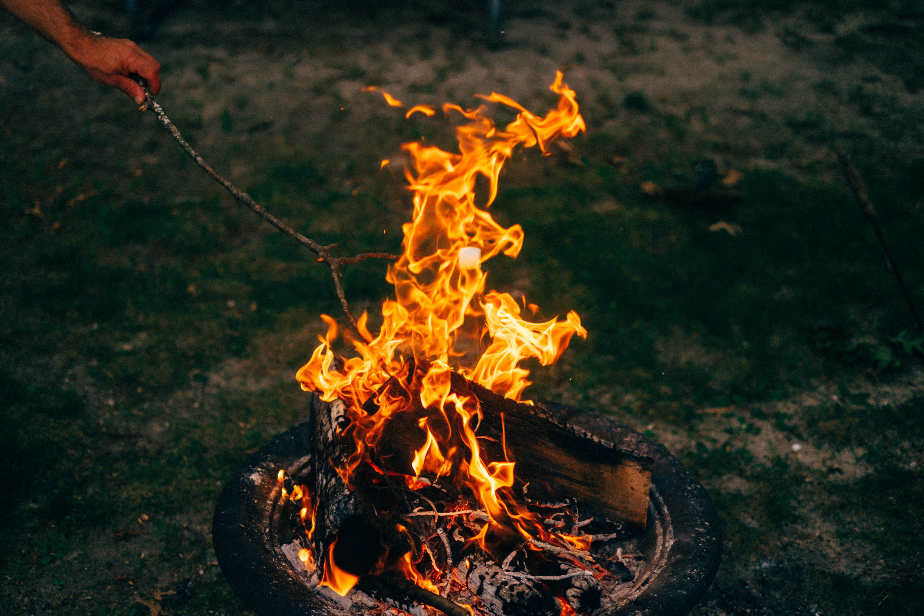
What will the children be doing in the evening?
Games/activities organised by JBL
Campfire- led by Adventure plus- one evening
In Yurts and lights out 9:00-9:30pm
Asleep by 9:30-10:00pm

Slide 12
What opportunities do these residentials offer?
Safety and encouragement
Stepping out of your comfort zone
Building skills and confidence
Teamwork
Positive learning environment

Slide 13
What you will need…
Kit list – layers are a must (even in summer!)
Sun lotion (hopefully!)
Lunch box and water bottle.
Playing cards/magazines/books can be taken – responsibility of children
A small bag of sweets
No mobile phones
No aerosols please!
No electronic devices

Slide 14
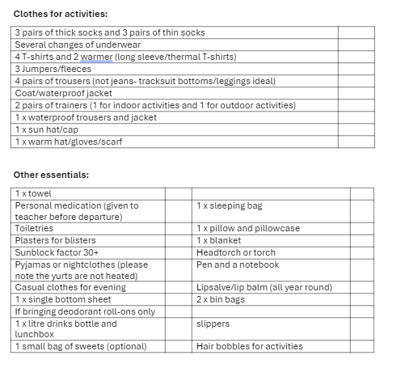
Kit list

Slide 15
Behaviours and Expectations.
We have the same high expectations of behaviour outside of school as in school.
We want all of the children to enjoy it and make life-long memories of their residentials.
If for any reason behaviour falls short of expectations, we will phone home for your child to be collected and they will then be expected to go to school the next day.

Slide 16
Medicines handed to Mrs Kane on arrival at the site.
Total cost of the trip £225 per child (including £50 non-refundable deposit paid by 31st November)
Mrs El-Madi will set up a payment system on Parentpay and you can pay in instalments or pay the total in a lump sum.
Please could you complete and return the medical and dietry requirement form as soon as possible.

Slide 17
Any questions?

