Slide 1

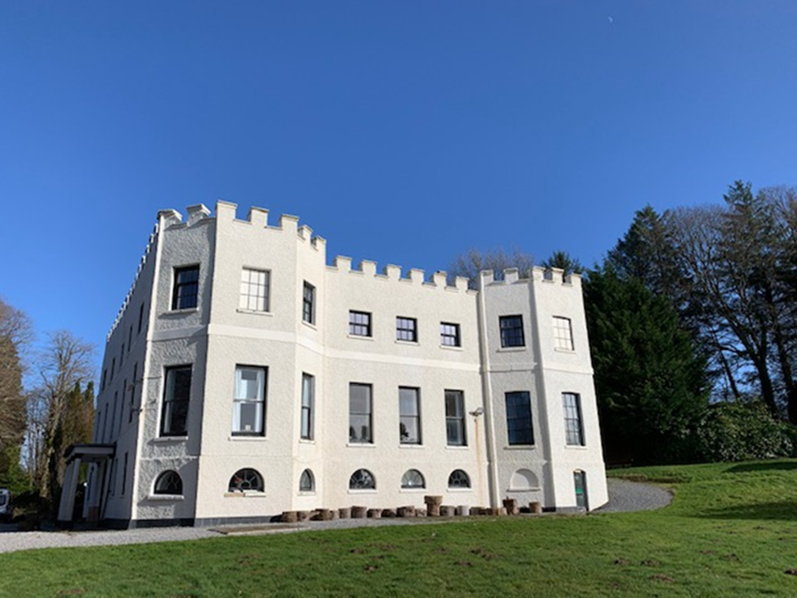
Kilvrough Manor
Swansea
OCC
Notes:
It was originally bought by Oxfordshire County Council over 50 years ago and since then has been running Residential Outdoor Education Courses for Primary and Secondary schools from Oxfordshire. Around 1600 Oxfordshire pupils take part in residential courses at Kilvrough every year.

Slide 2

Oxfordshire Outdoors
Kilvrough Manor Outdoor Education Centre
Notes:
Kilvrough is one of 3 Centres as part of our Oxfordshire Outdoors Learning Service. The Centres work closely together with our schools to offer high quality adventure residential education. We have very strong links with all of our schools. The service is part of Groundwork South Trust Limited who we have worked closely with since 2016 when we moved out of the Local Authority.

Slide 3
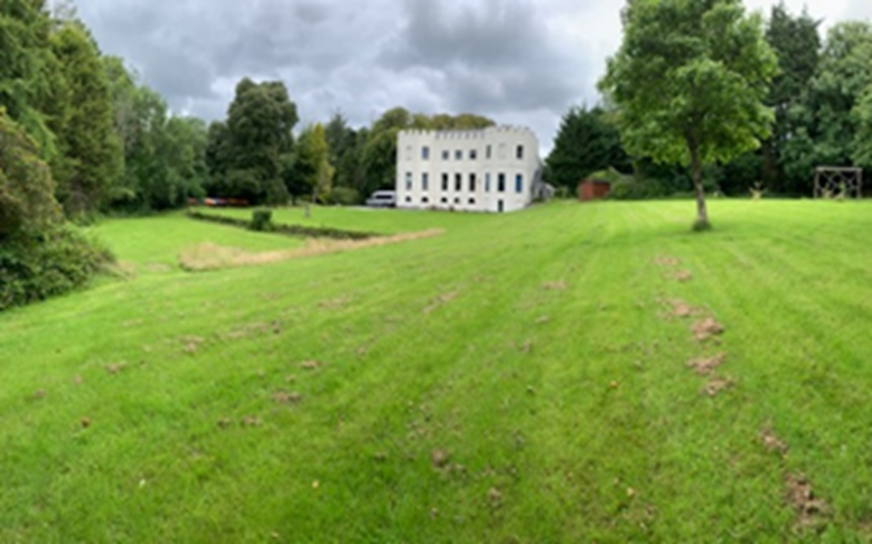
Monday 8th June – Friday 12th June 2026
Notes:
Kilvrough has acres of grounds to explore and enjoy both for activities in the day and in the evening. Our courses come all year round and we have good access to venues whatever the weather as we are close to the main road network. On site we have 2 classrooms, patio areas and spaces to enjoy. On site we have a a range of team building challenges and orienteering courses.

Slide 4
Monday 8th June to Friday 12th June
The coach will pick up from John Blandy at approximately 8.15am. We return about 6pm on the Friday (exact timings TBC).
Stop off at Service Station - children will need to bring a small snack and a drink. Kilvrough provide this on the return journey.
Packed lunch is needed for when we arrive at the centre.

Slide 5
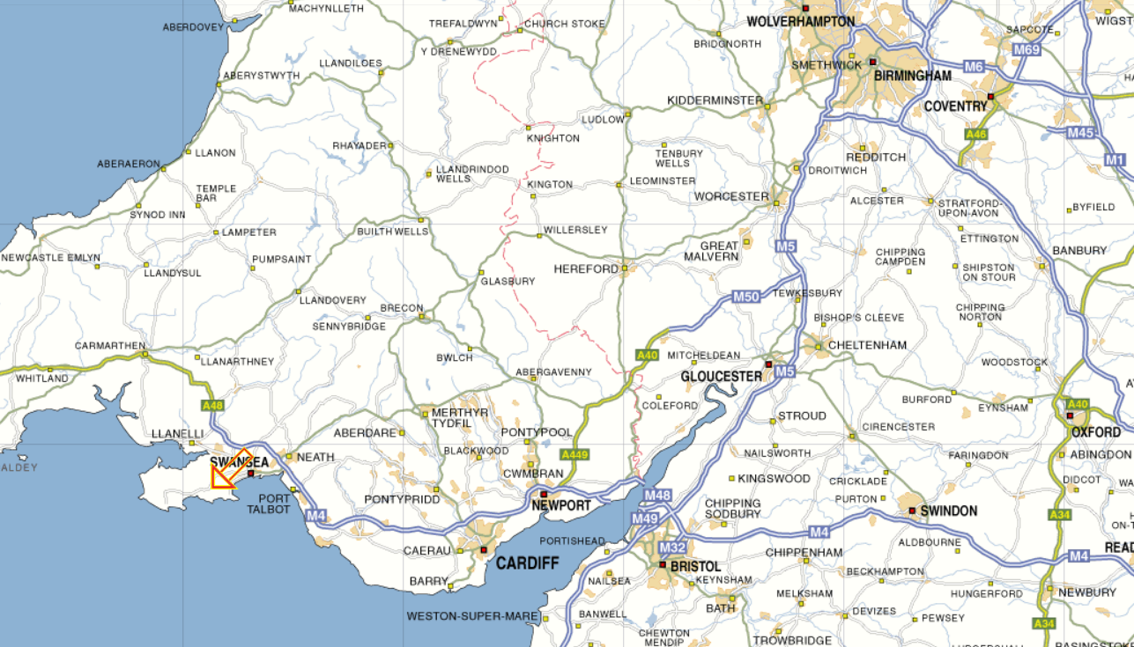
Where are we?
Notes:
Well worth the journey to experience our fantastic coastal and mountain environments

Slide 6
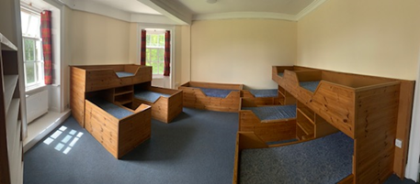
Quality Accommodation
Kilvrough Manor Outdoor Education Centre
Notes:
At Kilvrough we have flexible and comfortable accommodation, boys and girls are on separate floors and the are staff bedrooms close to the student rooms. The students have their own showers and changing areas on the ground floor which are easily accessible and close to the drying room which is ideal for coming back to from activities.
Most of our rooms are 4 or 6 bed. There are some with 8 and some with 2 beds. We have comfortable beds with plenty of space and storage areas. Most of our beds are bespoke. We provide pillows and duvets. Pupils bring their own duvet cover, pillow case and mattress cover/bottom sheet.

Slide 7
Rooms
Girls and Boys on separate corridors with own bathrooms.
At least one teacher on each corridor.
Children to choose 1 or 2 people to share with and rooms will be organised accordingly
Rooms of different sizes – up to 8 beds
Children will need to bring a single duvet cover, pillow cover and single mattress cover.

Slide 8
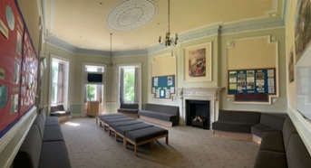
Common room / Lounge
Kilvrough Manor Outdoor Education Centre
Notes:
We provide pillows and duvets and a mattress cover. Pupils bring their own duvet cover, pillow case and mattress cover/bottom sheet.

Slide 9
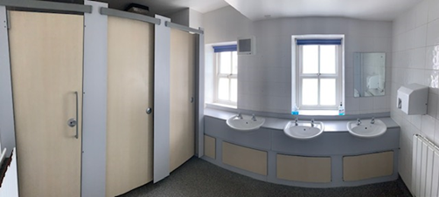
Bathrooms
Kilvrough Manor Outdoor Education Centre
Notes:
At Kilvrough we have flexible and comfortable accommodation, boys and girls are on separate floors and there are staff bedrooms close to the student rooms. The students have their own showers and changing areas on the ground floor which are easily accessible and close to the drying room which is ideal for coming back to from activities. We provide pillows and duvets and a mattress cover. Pupils bring their own duvet cover, pillow case and mattress cover/bottom sheet.

Slide 10
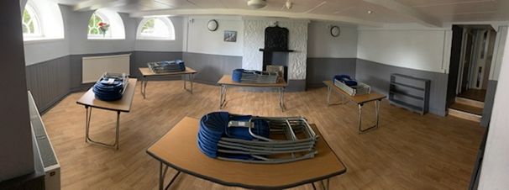
Dining Areas and Catering
Kilvrough Manor Outdoor Education Centre

Slide 11
Who will be going…
Some of the class teachers. Other John Blandy staff still to be confirmed.
OCC instructors will be running the activities during the day. One instructor will run evening activities along with school staff and be on site until 9pm.
We maybe sharing the centre with another school this will be confirmed nearer to the time.

Slide 12
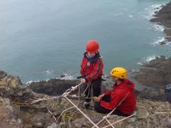
Day Activities
(Examples)
First day - Problem solving and team building games, issuing out kit and getting settled in.
Rock climbing and abseiling
Caving
Canoeing / Kayaking
Mountain and coastal walk / exploration
Surfing and Body boarding (weather and time of year dependent)

Slide 13
Evenings
Evening meals – special dietary requirements. Please let us know as soon as possible.
Games/activities (e.g. night hike, orienteering around the grounds)
Last evening – packing, games.
In rooms by 9/9.30pm, lights out and asleep by 9.30/10pm (depends on time of evening activity)

Slide 14
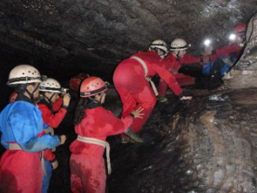
Safety and Encouragement
Kilvrough Manor Outdoor Education Centre
Notes:
We make sure that all pupils feel safe and they are positively encouraged to try all challenges by our staff school staff and fellow pupils. All get a chance to lead.

Slide 15
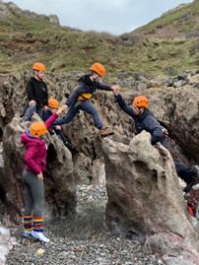
Stepping Out of Your Comfort Zone
Kilvrough Manor Outdoor Education Centre
Notes:
We encourage and help pupils to step out of their comfort zone, for some it might be the activities – for others it could be time away from home and getting themselves organised.

Slide 16
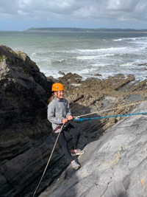
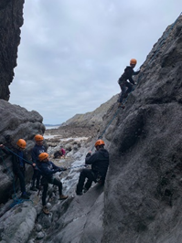
Building Skills and Confidence
Kilvrough Manor Outdoor Education Centre
Notes:
We enable the pupils learn skills and progress through different challenges, at first they practice on short easier sections before trying harder climbs.

Slide 17
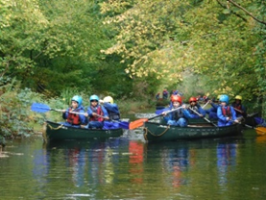
Positive Learning Environment
Kilvrough Manor Outdoor Education Centre
Notes:
We create a safe and supportive environment so that he pupils can get the most from their week and enjoy learning – challenging and fun.

Slide 18
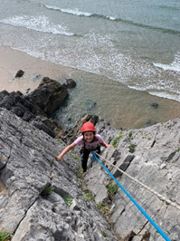
Discover your potential
Kilvrough Manor Outdoor Education Centre
Notes:
Some of the activities are new for the students. This pupil has developed considerable confidence!

Slide 19
Trust and Responsibility. Learning to manage risks safely
Woodlands Outdoor Education Centre
Notes:
Everyone takes part and learns how to keep themselves and others safe. These are some of our learning aims for all pupils.

Slide 20
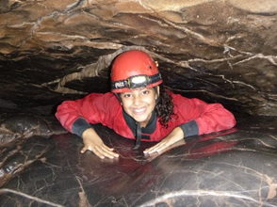
Effort and Achievement
Kilvrough Manor Outdoor Education Centre
Notes:
We aim for all students to achieve each day and are able to reflect on their success.

Slide 21
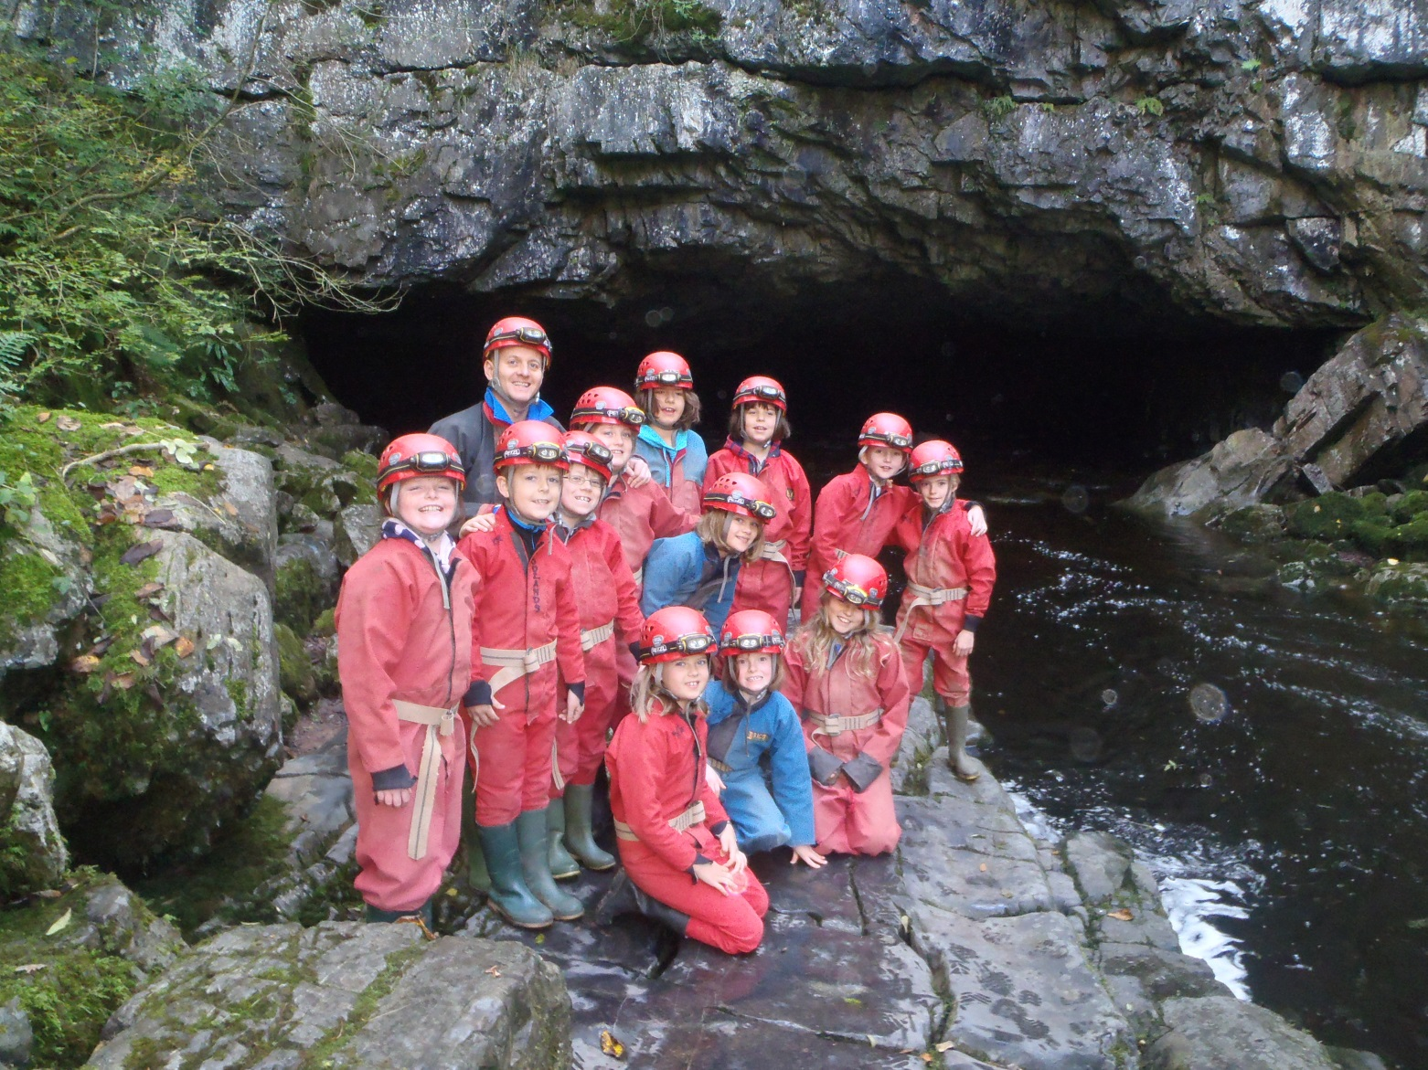
Enjoying Challenges Together
Kilvrough Manor Outdoor Education Centre
Notes:
A really important part of the learning is how our staff and school staff work together with the pupils. The pupils and staff gain greater understanding and respect for each other which carries on back at school.

Slide 22
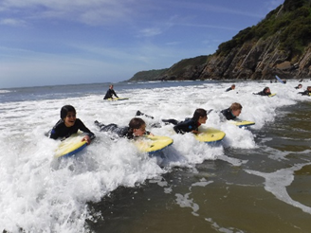
Enjoyment and Success
Woodlands Outdoor Education Centre
Notes:
Pupils and staff are involved in planning and setting challenges so all are involved in learning and feeling successful

Slide 23
A Range of Activities
Kilvrough Manor Outdoor Education Centre
Notes:
This is a sample programme – we can tailor your programme to your requirements and course aims. We do make changes to suit the needs of the group or the prevailing weather conditions.

Slide 24
Daily Routine
Time | Activity
07:30 | Wake Up
07:45 | Duty team to the Dining Room
07:55 | Everyone meet in the Lounge
08:00 – 08:40 | Breakfast
08:40 – 09:00 | Duty Team Clear the Dining Room Tidy Bedrooms for inspection
09:00 – 09:10 | Bedroom inspection by Visiting Staff Kilvrough Staff Meeting
09:10 – 09:30 | Whole Staff Meeting (Visiting Staff and Kilvrough Staff) Students organise shower kit Students organise activity clothing
09:30 – 09:40 | Lounge Briefing for everyone
09:40 – 10:00 | Activity Group Meetings
10:00 – 10:30 | Organise activity equipment Depart for activity
10:30 – 16:15 | Activity Day
16:15 – 16:30 | Clear away activity equipment Hang wet clothes in Drying Room Clean out the buses
16:30 – 17:30 | Shower time Free Time
17:30 – 17:40 | Duty team set up for Dinner
17:40 – 17:45 | Everyone to meet in the Lounge
17:45 – 18:45 | Dinner Time
18:45 – 19:00 | Duty Team clear tables Everyone else get ready for activity
19:00 – 20:45 | Evening activity programme
20:45 – 21:00 | Evening activity programme ends Lock up of the Centre KM Staff depart & hand over to Visiting Staff
21:00 -? | Bedtime
Kilvrough Manor Outdoor Education Centre
Notes:
This is a sample programme – we can tailor your programme to your requirements and course aims. We do make changes to suit the needs of the group or the prevailing weather conditions.

Slide 25
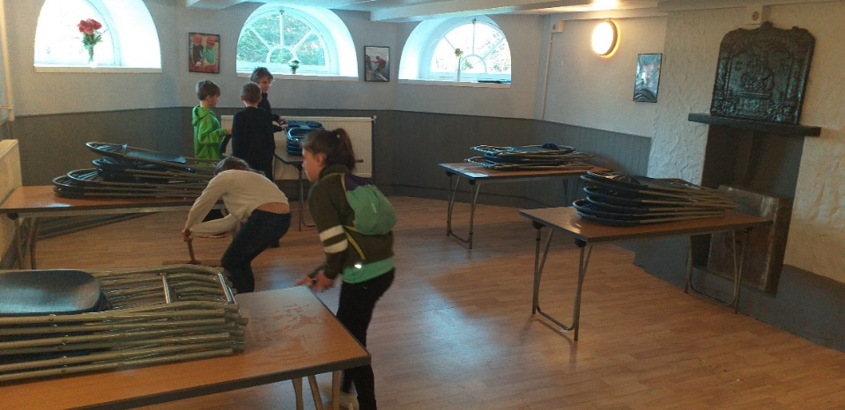
Jobs
Making beds
Keeping rooms tidy
Tidying up kits after our activities
Making lunches
Preparing for breakfast / dinner
Clearing up after
dinner/breakfast

Slide 26
What you will need…
Kit list – layers are a must (even in summer!)
Sun lotion (hopefully!) and swimming kit
Lunch box and water bottle.
Playing cards/magazines/books can be taken – responsibility of children
A small bag of sweets
No mobile phones
No aerosols please!
No electronic devices

Slide 27
Kit List
CLOTHES FOR ACTIVITIES |  |  | √
5 pairs thick socks and 5 pairs thin socks (not trainer socks)
Several changes of underwear
T shirts
3 – 4 warm T-shirts / thermal tops
3 – 4 pairs long sleeved fleece tops / Jumpers
3 – 4 pairs trousers (jeans are not suitable for activities) tracksuit bottoms or leggings are ideal
2 pairs of Fleece / woollen gloves or mitts, warm hat, balaclava, scarf
Swimming costume
Coat / Jacket
2 pairs trainers – 1 for normal use + 1 old pair for wet activities
OTHER ESSENTIALS | √ | OTHER ESSENTIALS | √
2 x good sized towels |  | Wellington or waterproof boots
Personal medication |  | Torch and spare batteries
Plasters for blisters |  | Writing materials
Toiletries etc. ** |  | Lypsyl or lip salve (all year round)
Sun block – Factor 30+ & sun hat |  | 2 x bin liners
Pyjamas or night clothes |  | 1 Litre drinks bottle & Lunch Box
Casual clothes for evenings |  | Slippers/ indoor shoes
NOTES
Please note the following: - Waterproof jackets and over trousers, wellington boots and day rucksacks are available to borrow from the Centre at no charge **Aerosol deodorants are not allowed at the Centre. Please being a suitable alternative if required Chewing gum is not allowed at the Centre, please do not bring it. Students are asked to make sure their clothes and other items are clearly marked with their name; this is especially important for medication such as inhalers. The Centre cannot accept responsibility for any valuables, we do not have a safe for student valuables and Centre staff are not allowed to look after them. Your stay at one of the Centres is an opportunity to experience time away from mobile and electronic devices – please do not bring mobile phones.
The courses at the Centre involves a lot of time outdoors, whatever the weather, and there is the likelihood of clothes getting wet and muddy. Weather conditions can be unpredictable during both summer and winter, so it is best to come prepared for the worst and then enjoy whatever happens knowing you have more than you need! So, hard wearing, warm clothes that you are happy to get wet and dirty are best. The following should be regarded as a minimum for all 5 day courses.
Kilvrough Manor Outdoor Education Centre
Notes:
This is a sample programme – we can tailor your programme to your requirements and course aims. We do make changes to suit the needs of the group or the prevailing weather conditions.

Slide 28
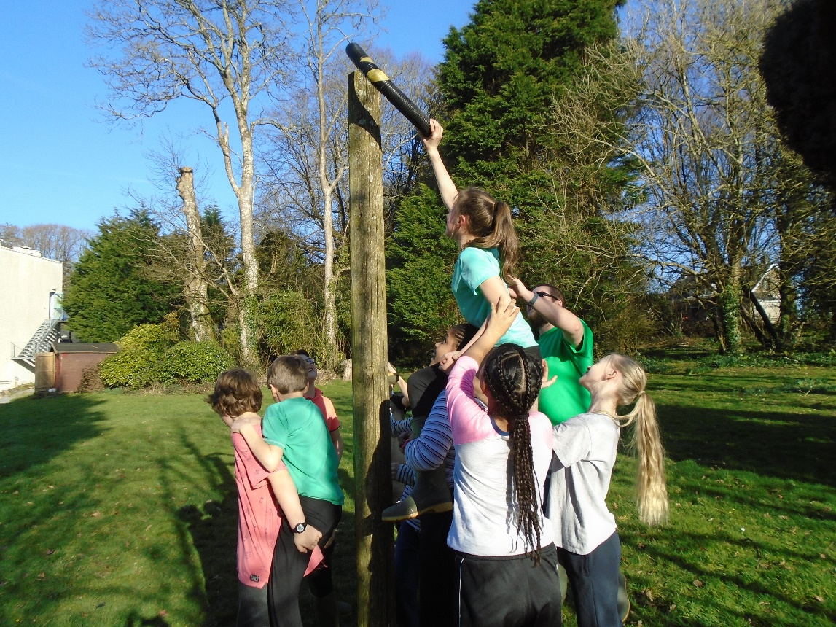
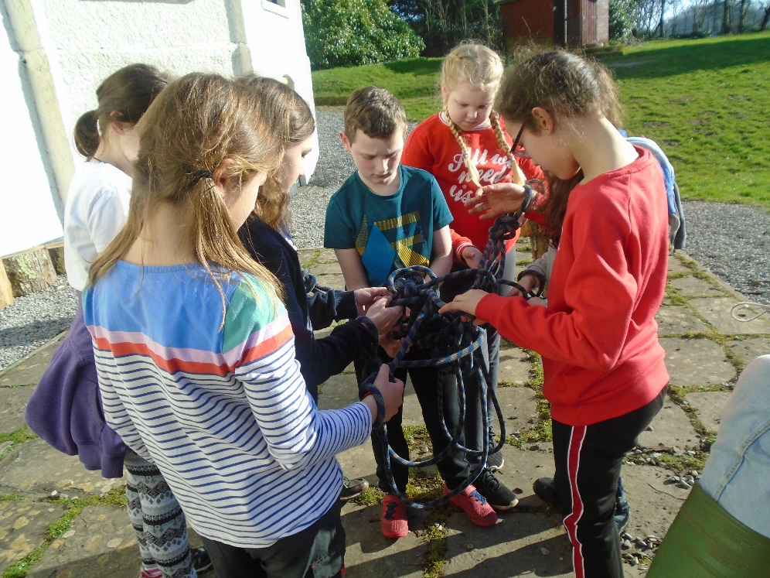
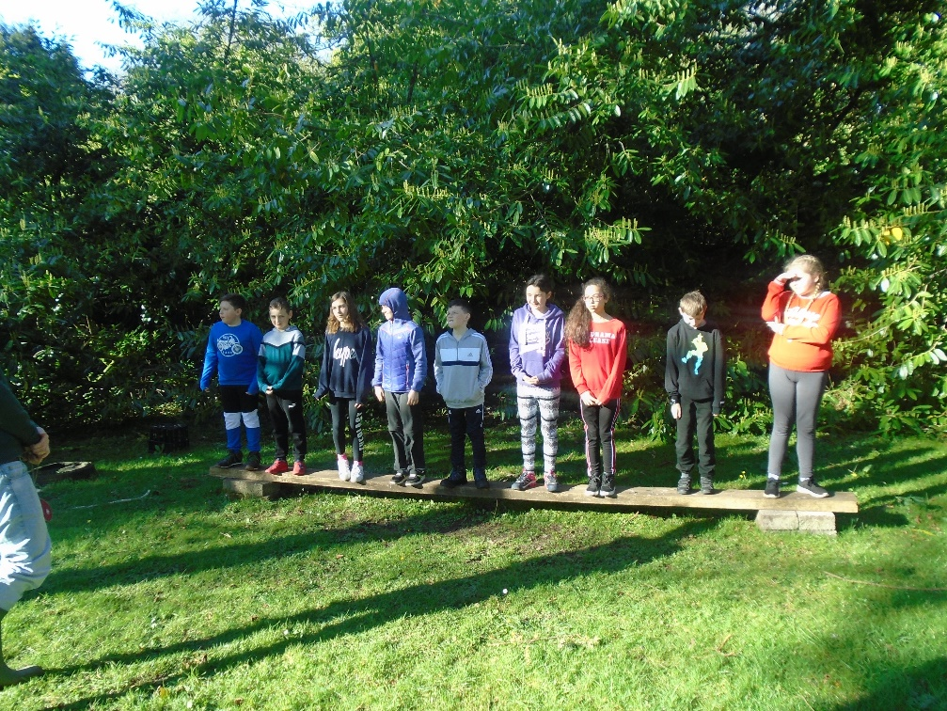

Slide 29
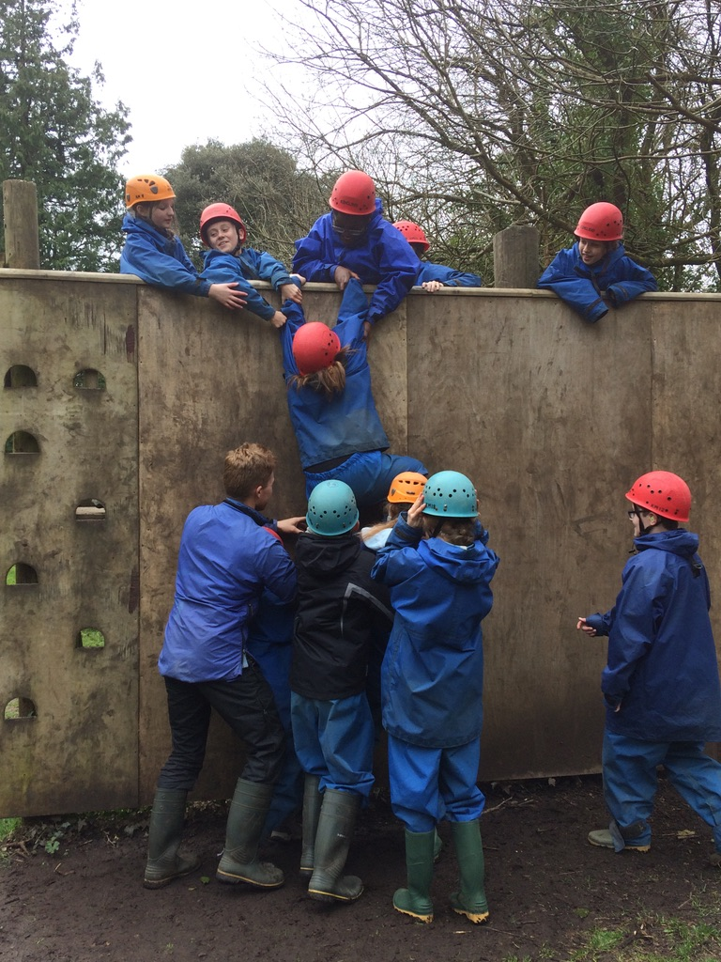

Slide 30
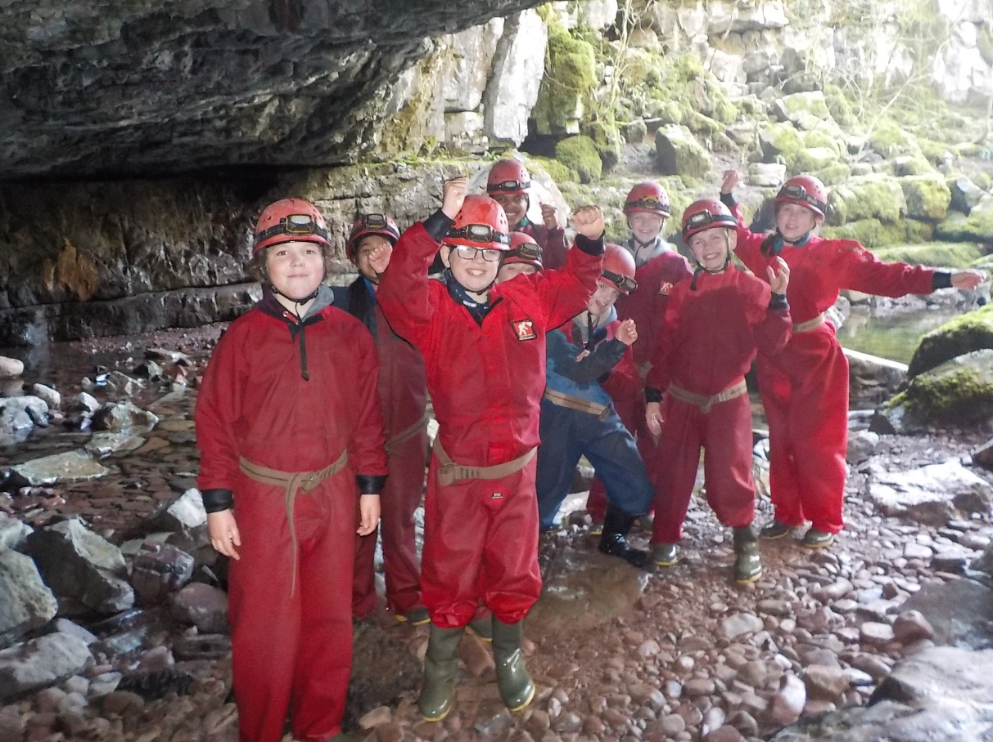
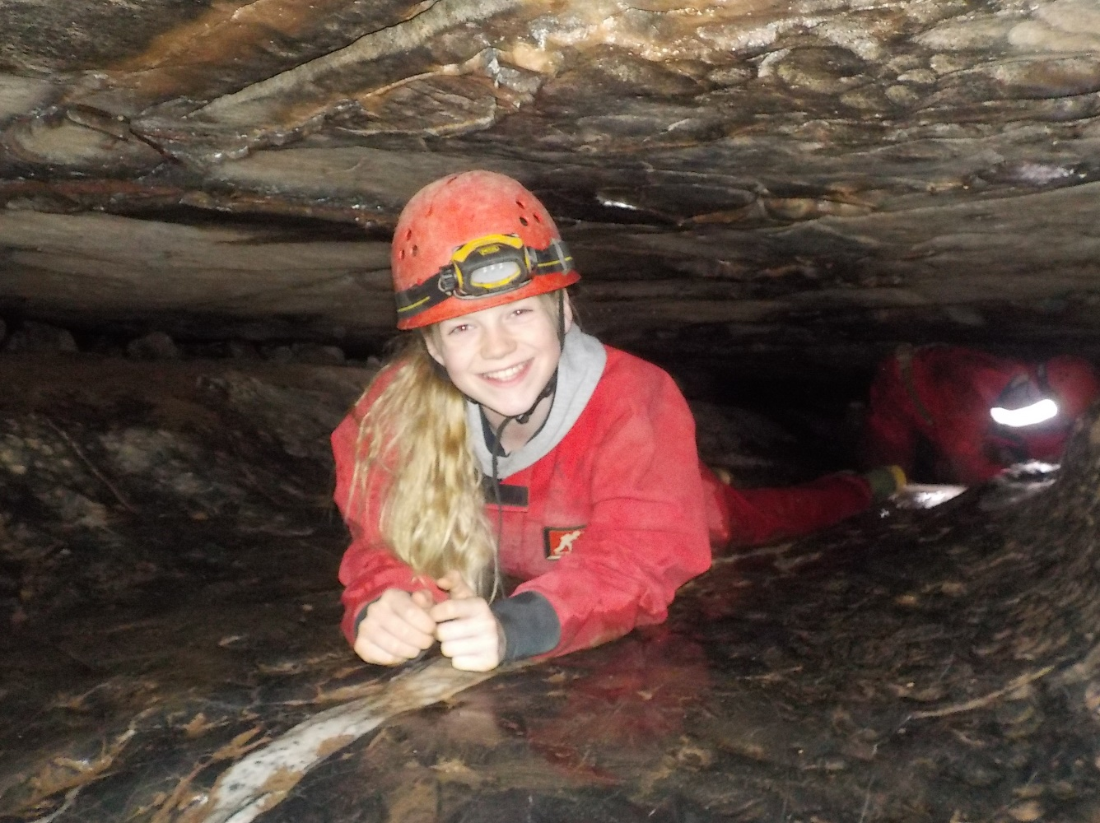

Slide 31
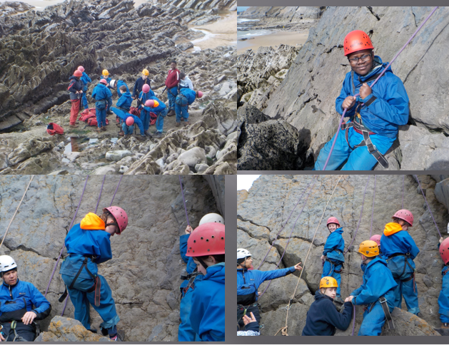

Slide 32
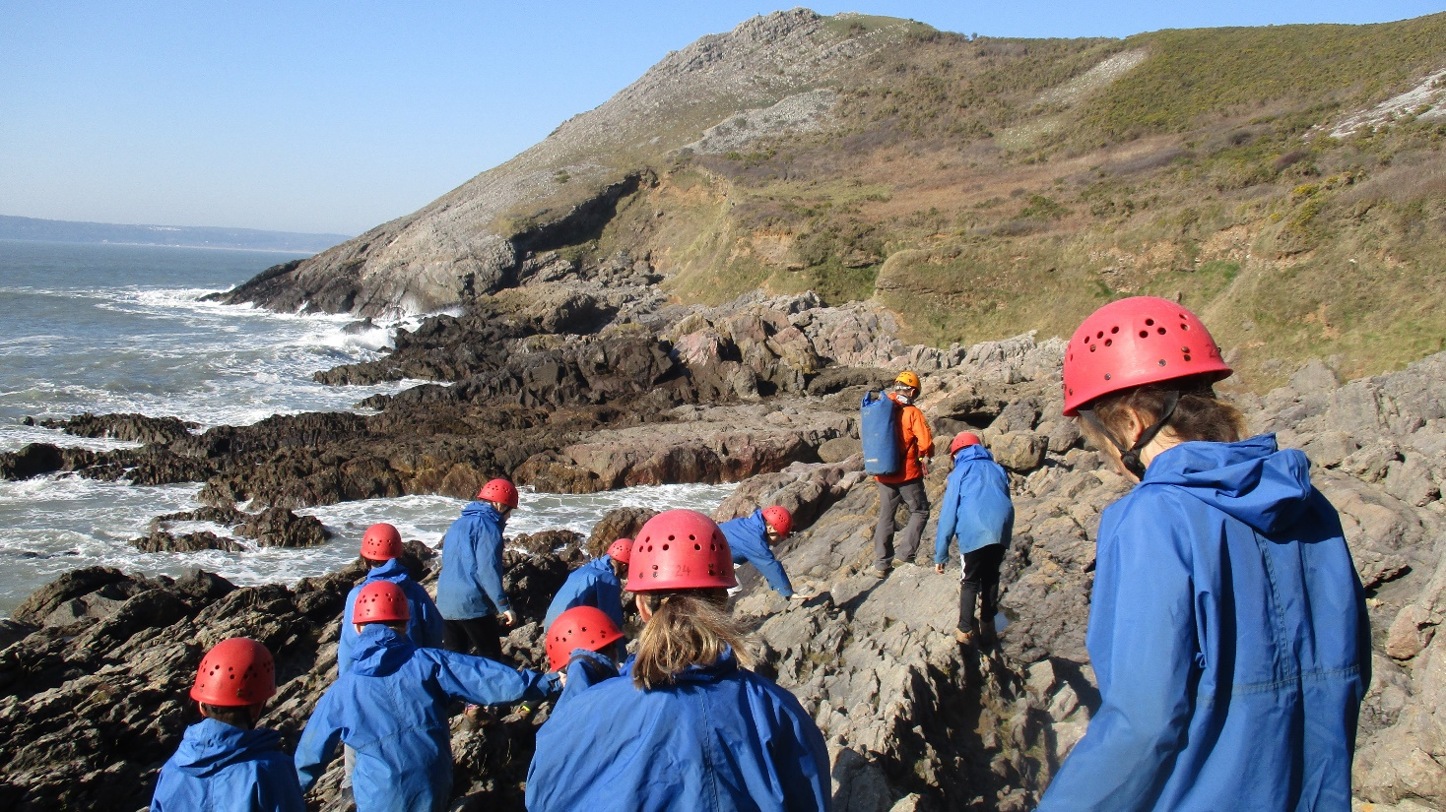
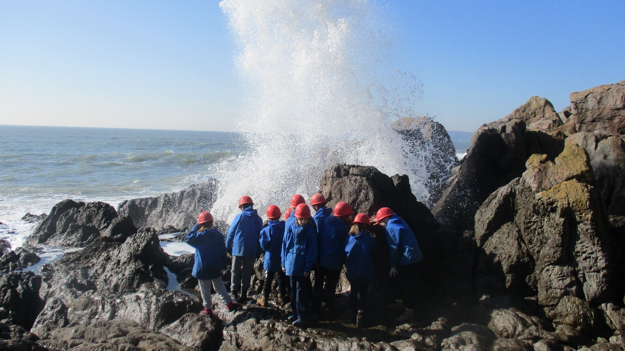

Slide 33
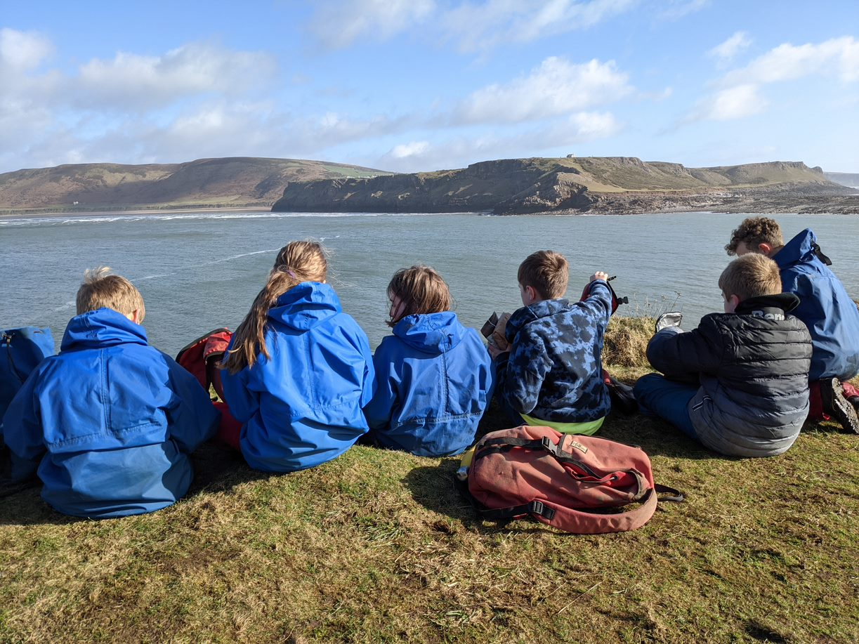
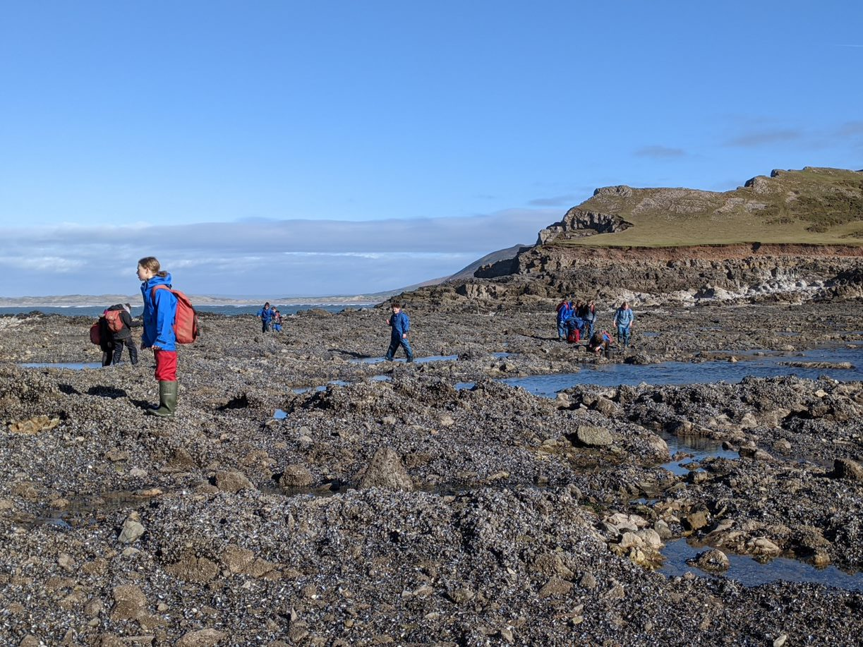
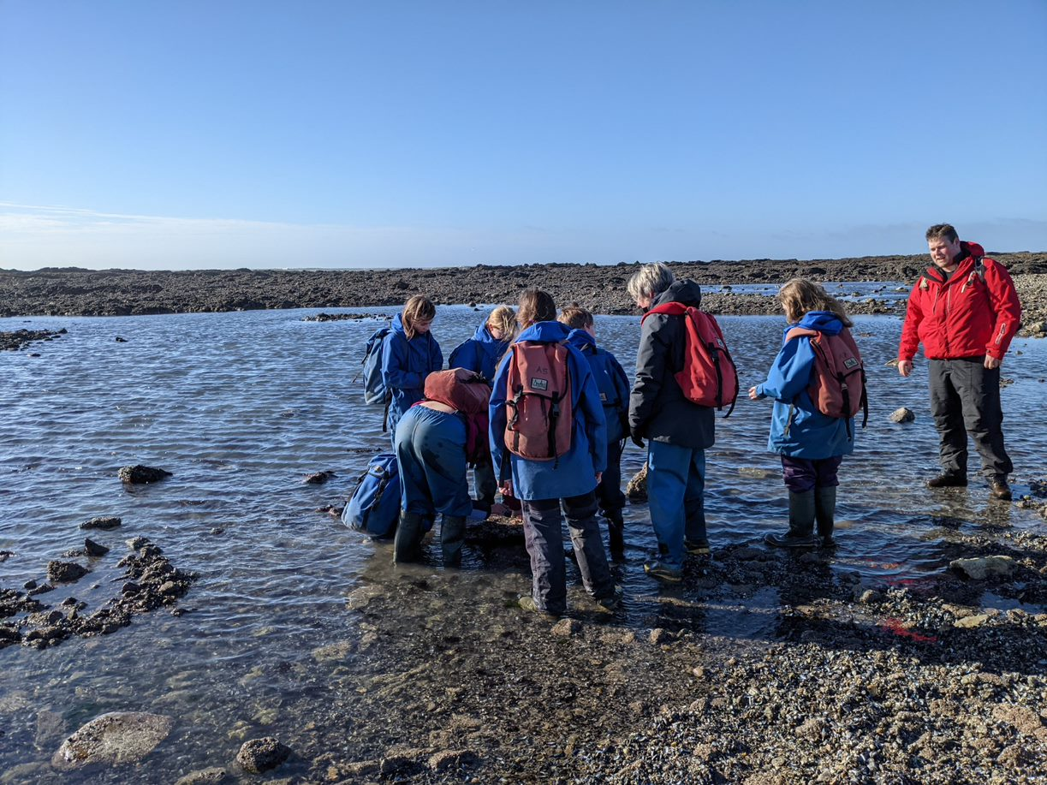
Worm's Head

Slide 34
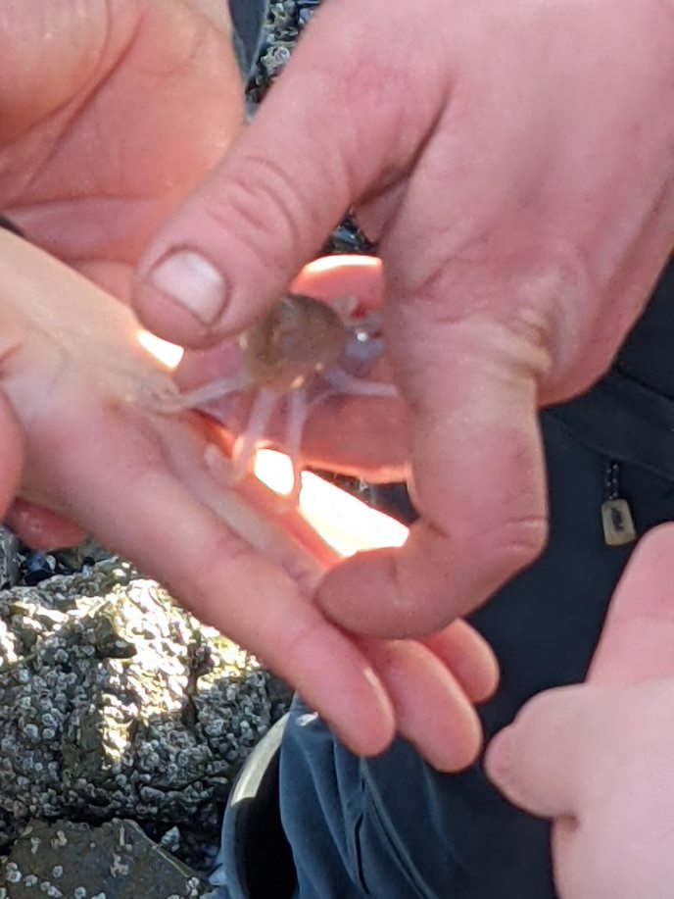
Octopus

Slide 35
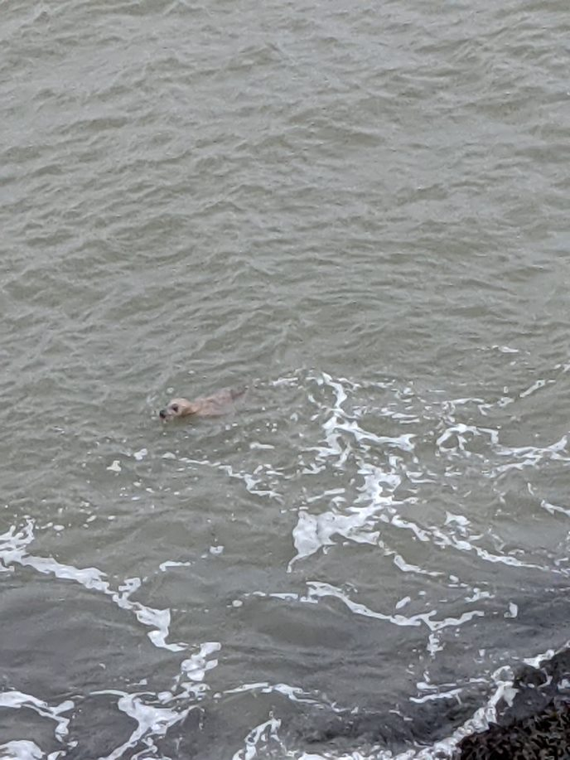
...and seals!

Slide 36
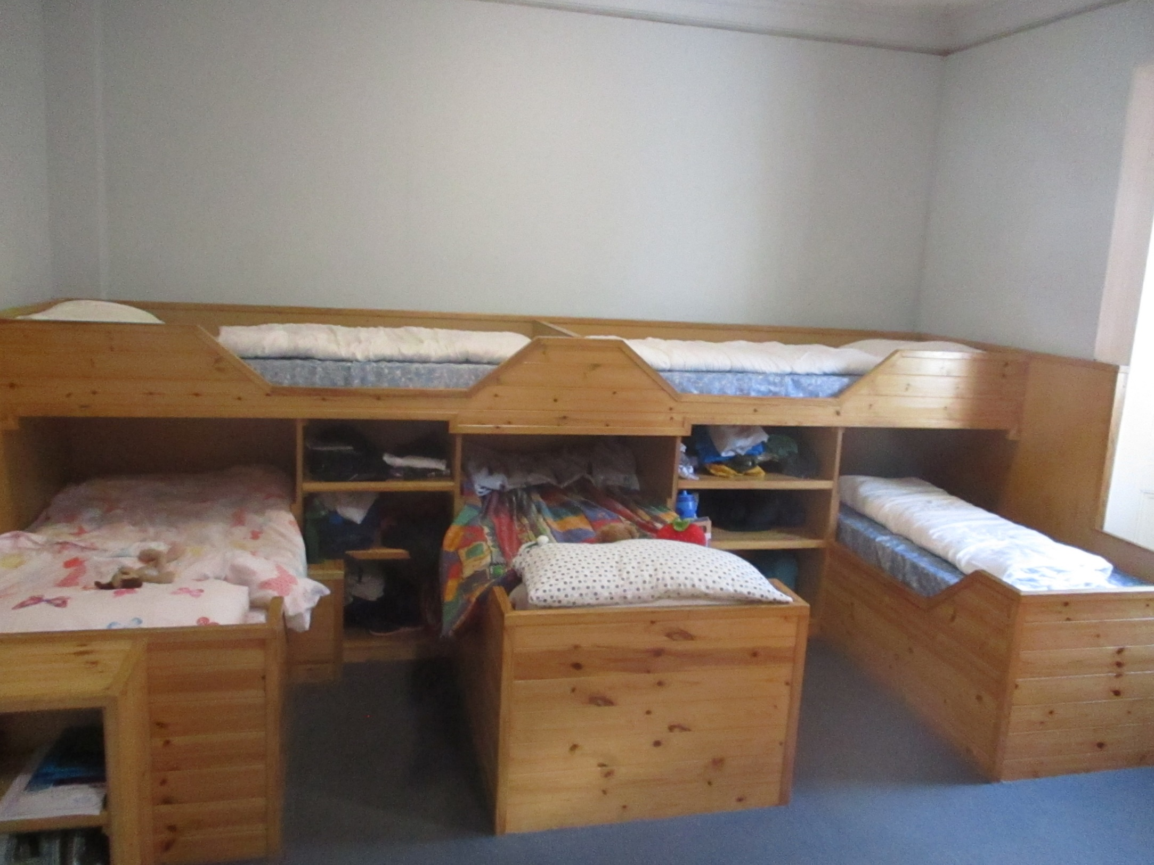

Slide 37
Merchandise
Hoodies and/or T-shirts – will need to be pre-ordered. Details to follow later in the year.
Shop items – there will be a small selection of items to buy on the last evening at Kilvrough (eg key rings). Details tbc closer to the time. Children will need to bring in the exact money for the items they want and hand this in on the morning of departure.

Slide 38
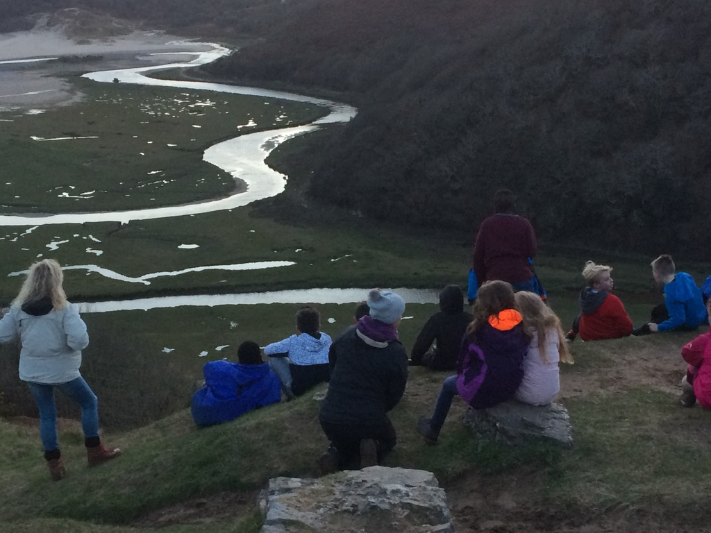
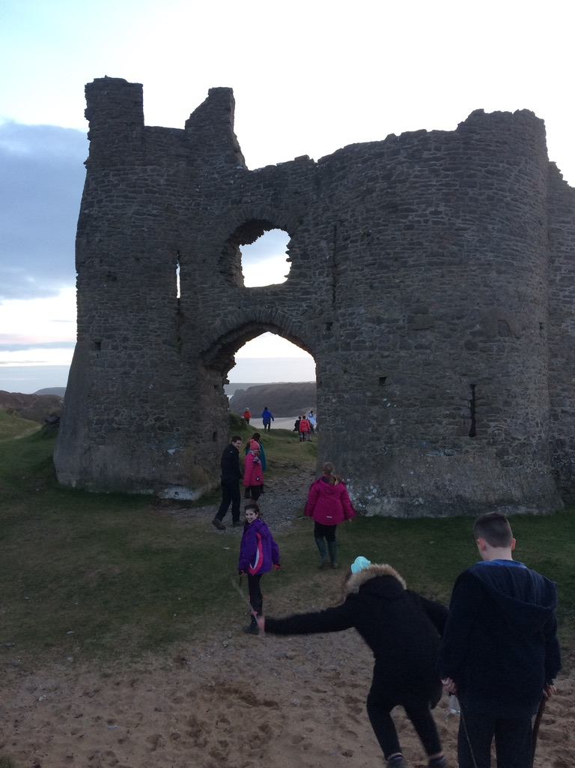
Evening walk to Pennard Castle

Slide 39
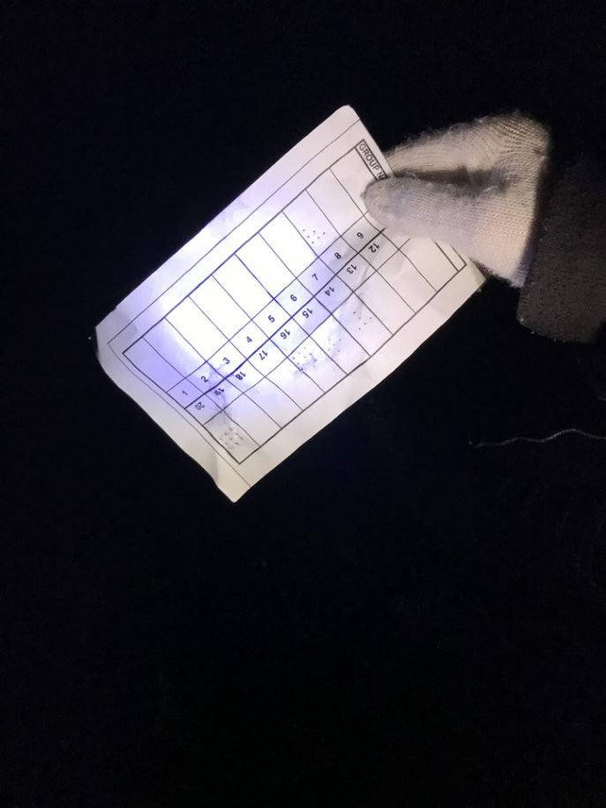
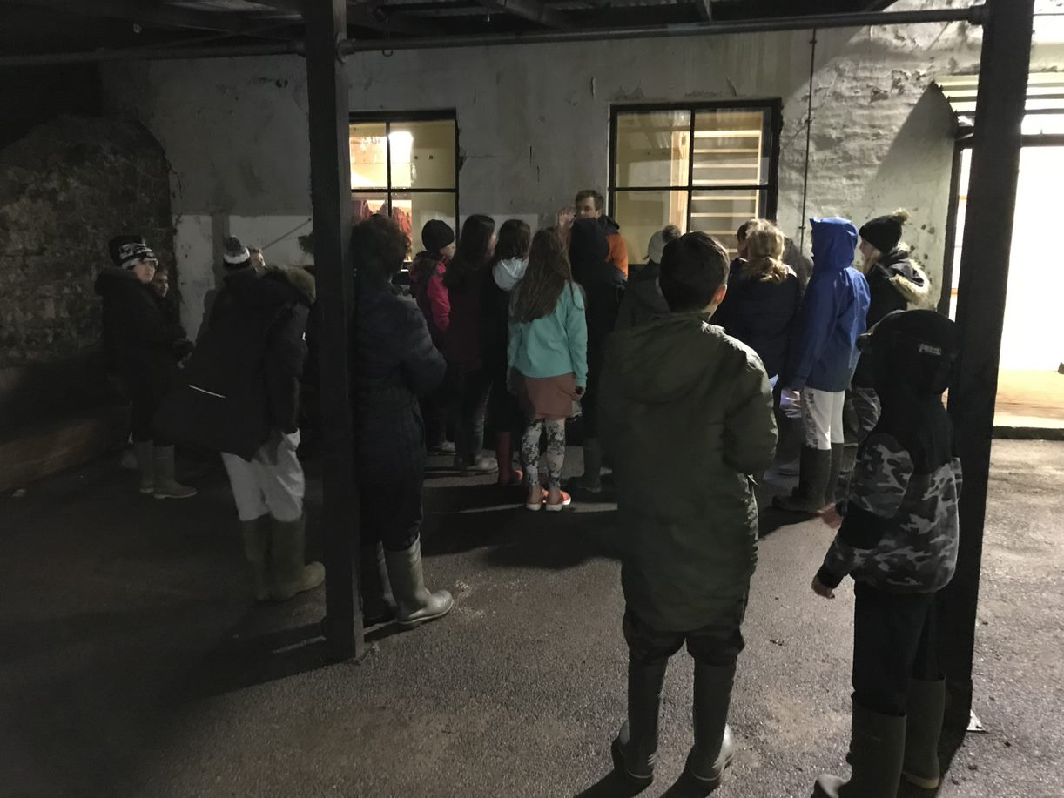
Orienteering in the dark!

Slide 40
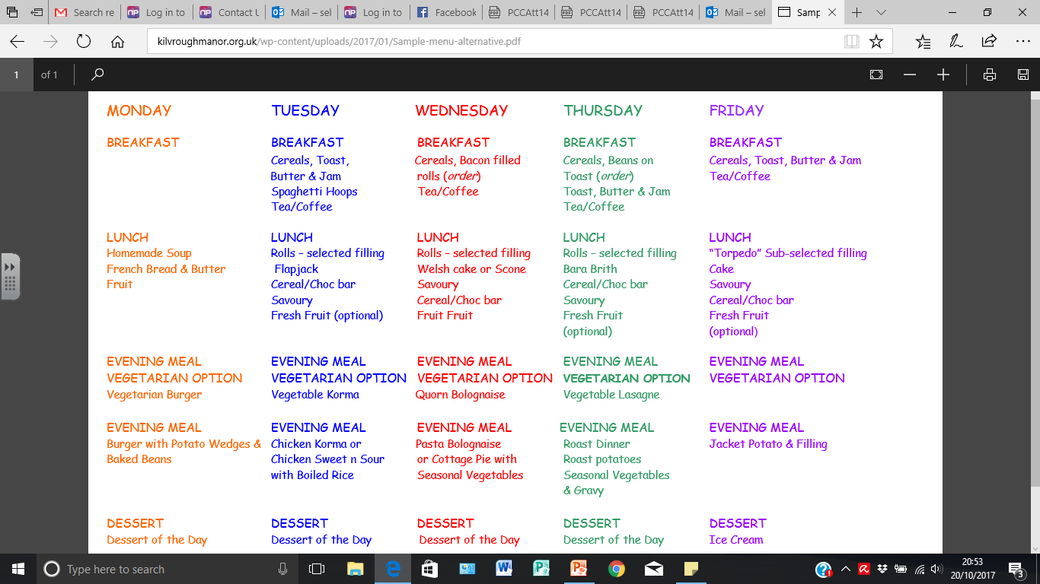

Slide 41
Medicines – handed in to designated adult on arrival at school.

Slide 42
Total cost is £396 which includes coach, activities, accommodation and food as well as hiring of all the equipment there.
£76 - 31/10 — non-refundable deposit
£64 - 26/11
£64 - 31/01
£64 - 28/02
£64 - 31/03
£64 - 30/04
Any questions or concerns- please catch us on the playground at the end of the day or email via the school office.
Please could you complete and return the Parental Consent form as soon as possible.

Slide 43
Any questions?

