Slide 1
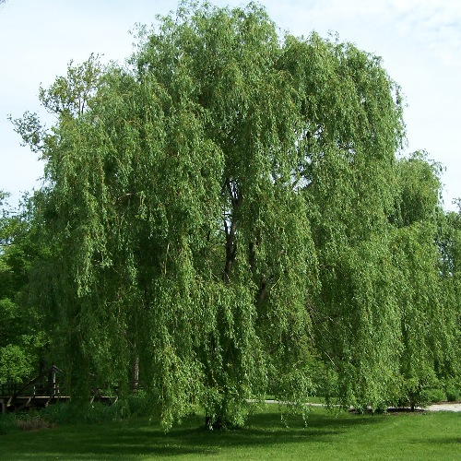

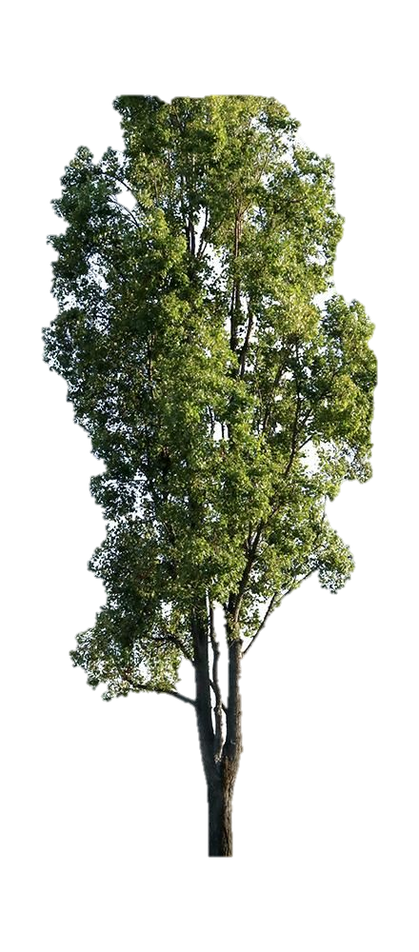
Welcome to Year 5/6
Poplar, Willow and Maple Class

Slide 2
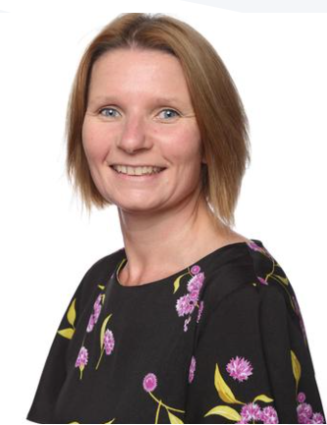
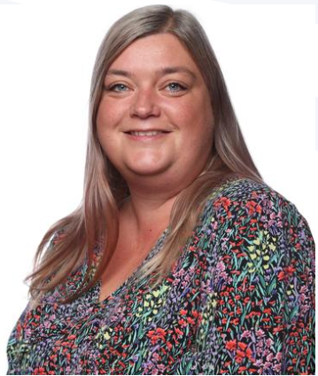
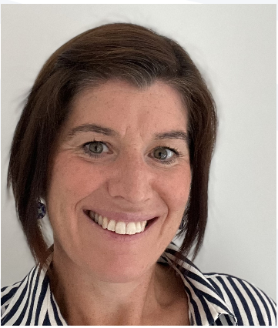
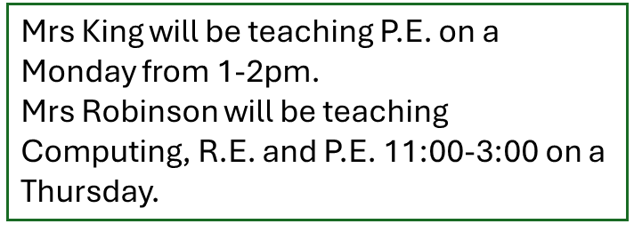
Staff- Willow Class
Taught by: Mrs Kane
Class TA: Mrs Stanley and Miss Forrest

Slide 3

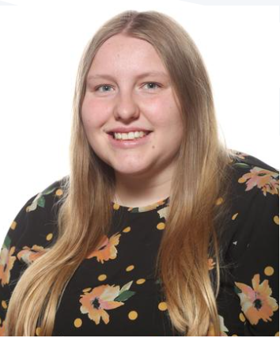
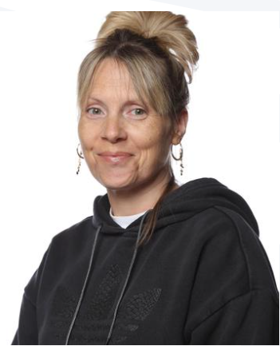
Staff- Maple Class
Taught by: Mrs Williams
Class TA: Mrs Parkins
PPA cover: Mrs Robinson (Thursday morning- R.E. and French)

Slide 4
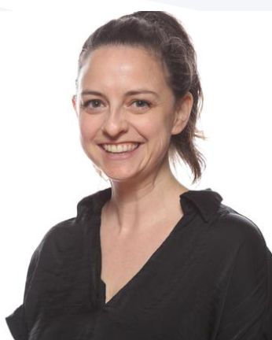
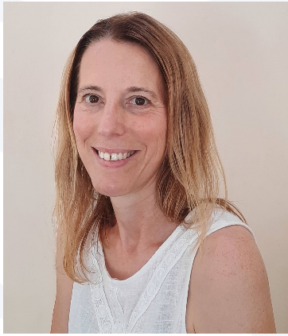
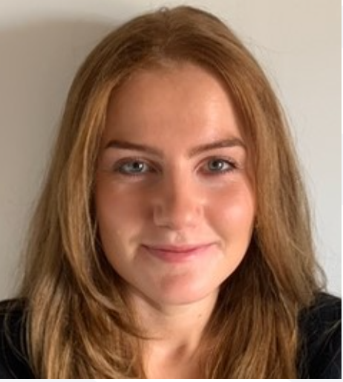
Staff- Poplar Class
Taught by: Miss Matheson and Mrs Fleet
Class TA : Miss Dixon
PPA cover- Mrs King (PE on Monday and Mrs Stanley ( Music and RE on Tuesday)

Slide 5
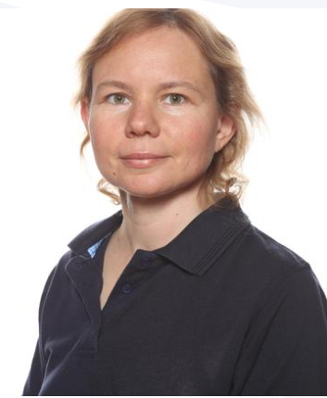
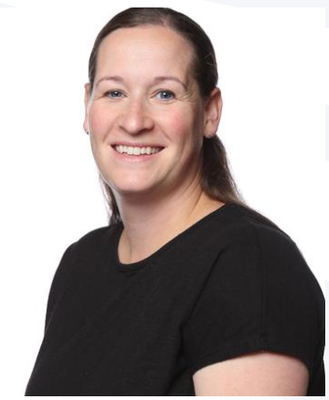
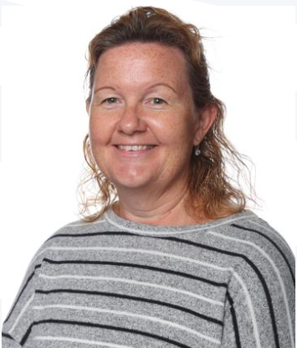
Staff
We are very lucky to have some other members of staff working across UKS2 during the week.
Ms Fakhretdinova Mrs King Mrs Robinson

Slide 6
The school day
8.30am – The children will arrive through the main entrance at Fir Tree Close, they should walk through the KS1 playground to the Rainbow building independently and straight into class. There are morning tasks for the children to complete on entry to the classroom to support them with their learning as soon as they arrive.
​
3pm – At the end of the day, the children will be walked out through the main Rainbow building door and across the KS1 playground. We will meet parents on the playground and will wait by the big post by Elm class.
If you wish for your child to walk home by themselves, the walking home from school e-form must have been completed. If you wish for your child to have a mobile phone on them for walking home, this must be switched off when entering the school gates and handed to the class teacher on entry to the classroom.
​

Slide 7
Equipment needed:
(Please make sure everything is labelled clearly!)
Water bottle – daily
Correct school uniform and PE Kit (to be in school on P.E. days)
Pencil case – pencil, sharpener, blue ink pen (not biro), ruler, coloured pencils.
Appropriate outdoor clothing (e.g. coat, hat)
Healthy snack for break
Lunch box if having home packed lunch

Slide 8

Curriculum
Daily Maths/ English lessons
Daily Phonics/WCR
•Non-core PM (Curriculum Web)
PE
Willow- Monday (indoor), Thursday (outdoor)
Maple- Tuesday (indoor), Wednesday (outdoor)
Poplar – Monday (outdoor), Wednesday (indoor)
Our focus text for the Autumn term is London Eye Mystery
Please feel free to bring your own copy in for our English lessons

Slide 9

Swimming- Year 5 and invited Year 6
Dates: 6th & 13th October
10th , 17th and 24th November
1st December
Arrangements : We will be taking Year 5 children swimming and those invited from Year 6. We will be splitting into two groups and the coach will drop off and collect each group from the pool.
Year 6 – please confirm if your child has met the end of KS2 requirements outside of school. Evidence can be screenshots, certificates, letter from the swim school. Please can we have this by Friday 19th September.
We will be swimming in the morning and therefore it is essential to arrive at school on time.
Equipment:
Towel
Swimming costume/trunks (no bikinis or Bermuda style shorts)
Swimming hat
goggles if your child wishes

Slide 10
This week, _______________________, I have read
 | Monday | Tuesday | Wednesday | Thursday | Friday | Saturday | Sunday
What have you read? Page numbers?
Maths focus
 | Spellings | number
W
Th
Fr
Sa
Su
M
Tu
Parent Comment (Optional):
Signed:_____________________________
Spellings
Teacher comment:

Slide 11

Homework- Year 5/6
Homework books will come home on a Wednesday.
Spellings tests and times table tests will be completed at the start of the week.
Expectations:
Reading – 5 x per week. Books need to be in school every day. Please record the book they have read, along with the page numbers read in your child’s homework diary. Do feel free to make a comment.
Times Tables – will be set weekly to retain/ develop fluency. (TImestables Rockstars, hit the button, timestables.co.uk) 3 x weekly
Spellings- will be set weekly. The children will start with 5 common exception words and will receive an additional 5 until they are at 20 words per week. This gives an opportunity to embed the spellings, transferring to long term memory. During week 5, the children remain with 20 spellings with the first 5 words 'falling off' as they receive new ones.
Homework books are checked weekly, so please use them as a means of communication.
Alternatively, catch us on the door at the end of the day or send a message via the School Office.
.

Slide 12



Expectations – additional homework Year 6
Additional homework books- Achieve Books (letter to follow)
- These will be set on a Thursday weekly from half term.

Slide 13

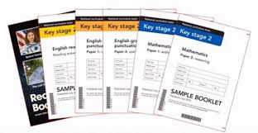
Year 6 SATs – week beginning 11th May 2026 (meeting to follow)
Please avoid past SATs papers. (CGP, scholastic books etc. instead)
SATs meeting TBC

Slide 14
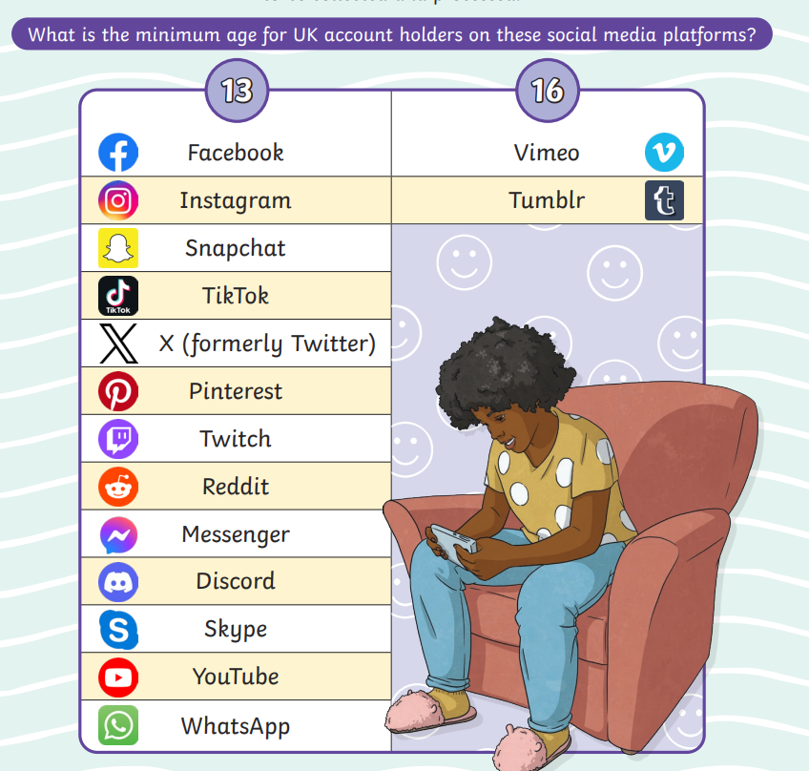
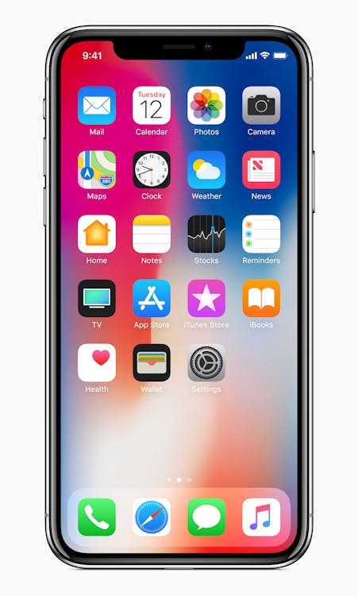
Internet safety and mobile phones
- Group chats
- Messages
- Searches and algorithms

Slide 15
Trips and Experiences
30th September IMPS- Y6 group 1
7th October IMPS- Year 6 group 2
8thOctober- Willow Class Williams STEM Day
9th October- Poplar Class Williams STEM Day
10th October- Maple Class Williams STEM Day
Year 6 Residential-8th -12th June- Kilvrough, Wales
Year 5 Residential- 24th, 25th, 26th June- Adventure Plus Clanfield

Slide 16

Dates:
24th September Y6- Kilvrough Residential meeting 3:15pm Willow Class
26th September MacMillan Coffee afternoon 2-3pm
1st October- Individual School Photo Day
7th October IMPS- Year 6 group 2
Y5 -Adventure Plus Residential meeting 3:15pm Willow Class
16th October Harvest assembly- 9:00am
-22nd & 23rd October - Pupil Progress Evenings (Parents' Evening)
Any Questions?

