Slide 1
Welcome to Year 3/4
Meet the Teachers – Tuesday 8th September 2026

Slide 2
Staff
Sycamore
Teacher – Miss Empson
TA – Mrs Stanley, Miss Dixon, Mrs Hougham, Mrs Penny
PPA Cover – Mrs King
Walnut
Teachers – Mrs Cairns (Mon-Wed) and Mrs Coultas (Thurs - Fri)
TAs – Mrs Smout and Miss Catherall
PPA Cover – Mrs Stanley and Mrs Green
Cedar
Teacher – Miss Hamill
TAs – Ms F
PPA Cover – Mrs Stanley and Mrs King

Slide 3

The School Day
The children have early morning work from 8:30am which will involve responding to feedback from previous work (purple pen) and quiet reading.
Following this, we have assembly three times a week and spellings/handwriting sessions on the other two days.
Whole Class Read will happen daily covering fluency, comprehension and an extended read.
Children will then do an hour of Maths and English every morning.
The afternoons will contain a quick maths fluency lesson and then will be filled with our non-core subjects.
PE/Games will take place twice a week.

Slide 4
Curriculum
PE
Sycamore – Monday (outdoor) Thursday (indoor)
Walnut – Wednesday (indoor) Friday (outdoor)
Cedar – Monday (outdoor) Friday (indoor)

Slide 5
Equipment needed:
(Please make sure everything is labelled clearly with their name!)
Water bottle – daily
Correct school uniform and PE Kit (to be left in school)
Pencil case – pencil, sharpener, blue ink pen (not biro), ruler, coloured pencils, whiteboard pen. No rubbers.
Reading book (from home, class library, school library)
Appropriate outdoor clothing (e.g. coat, hat)
Healthy snack for break (this is new for Y3s)
Lunch box if having home packed lunch

Slide 6
Homework
Homework books come home on a Wednesday.
Spellings and times tables tests will be towards the start of the week.
Reading – 5 x per week. Books need to be in school every day. Please record the book they have read, along with the page numbers read in your child’s homework diary. Do feel free to make a comment.
Times Tables –3 x week. Individualised times tables will begin soon and will then be set regularly.
Spellings - 4 x week. Children will start with 5 common exception words and will receive an additional 5 until they are up to 20 words per week. This gives an opportunity to embed the spellings, transferring to long term memory. During week 5, the children remain with up to 20 spellings with the first 5 words 'falling off' as they receive new ones. Spellings will be put on EdShed.

Slide 7
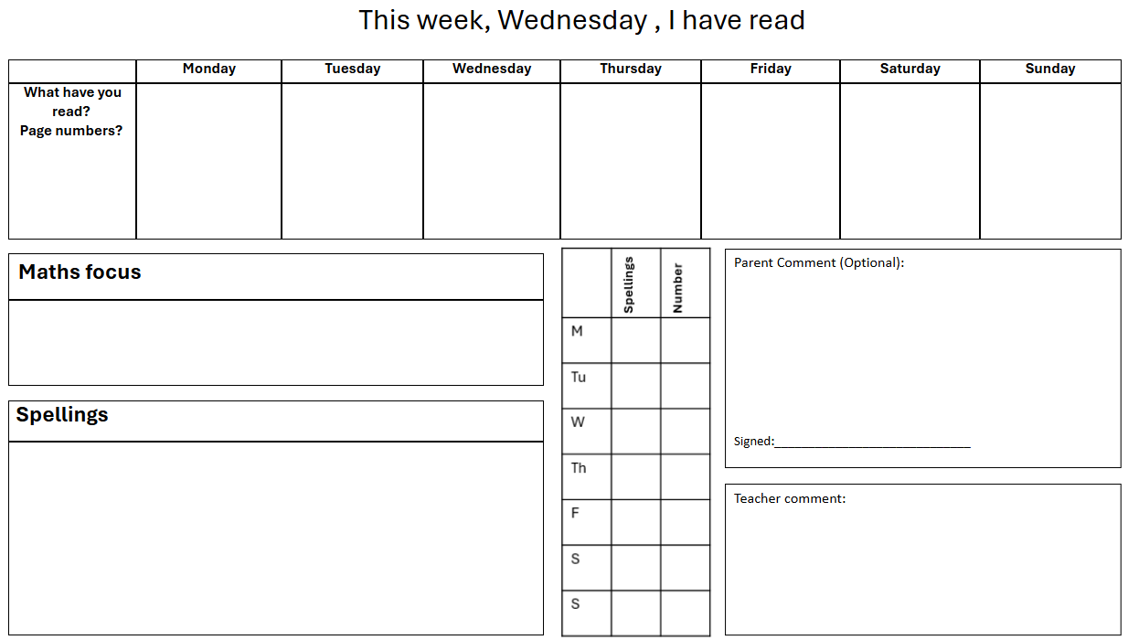

Slide 8
Communication
Homework books are checked weekly, so please use them as a means of communication.
Alternatively, catch us on the door at the end of the day or send a message via the School Office.
Due to safeguarding, please can we politely ask that you don't come into the Rainbow Building at the start of the day. If there is anything urgent that we need to know, please speak to the staff in the School Office and they will pass the information on.
Pupil Progress meetings will be on the Wednesday 21st and Thursday 22nd October.

Slide 9

Any Questions?

